Slide 1
DATA SCIENCE Class 1: Introduction and Tools
Notes:
~15-20 min on initial stuff
Note: example DS problem…write down some features, how could you build a predictive model from these?

Slide 2
WELCOME!
INTRO TO DATA SCIENCE
Notes:
Introductions
discuss student backgrounds
discuss reasons for interest in data science

Slide 3
Instructors: Aaron Schumacher, Kevin Markham, Sinan Ozdemir gadsdc2.hackpad.com Course Times: 6:30pm-9:30pm, Mondays and Wednesdays (1776) Homework / Projects
Logistics
Notes:
All of our classes will involve some hands-on work (in the exercises section)

Slide 4
0. Meta-intro I. What is data science? II. The Data mining workflow Lab: III. Working at the unix command line
agenda
Notes:
All of our classes will involve some hands-on work (in the exercises section)

Slide 5
0. Meta-intro
INTRO TO DATA SCIENCE
Notes:
~15-20 min for this section?

Slide 6
Learning is for everyone
META-INTRO
Notes:
~15-20 min for this section?

Slide 7
Learning is a consequence of thinking
META-INTRO
Notes:
~15-20 min for this section?

Slide 8
We are all students We are all teachers
META-INTRO
Notes:
~15-20 min for this section?

Slide 9
Communicate early and often
META-INTRO
Notes:
~15-20 min for this section?

Slide 10
I. What is data science?
INTRO TO DATA SCIENCE
Notes:
~15-20 min for this section?

Slide 11
What is DATA SCIENCE?
A set of tools and techniques used to extract useful information from data.
Notes:
This is pretty high level
Q: what kinds of tools & techniques do you think this means? (subject of this course…”useful” depends on the particular problem)
in general, DS is used to make intelligent decisions (frequently to satisfy business requirements)
Q: does anyone know of any examples?

Slide 12
What is DATA SCIENCE?
A set of tools and techniques used to extract useful information from data.
An interdisciplinary, problem-solving oriented subject.
Notes:
Combines math, computing, problem solving skills, communication
Practical subject, not very formal/rigorous.
Problem solving skills are key!

Slide 13
What is DATA SCIENCE?
A set of tools and techniques used to extract useful information from data.
An interdisciplinary, problem-solving oriented subject.
The application of scientific techniques to practical problems.
Notes:
Scientific = math & computing as above…practical = important to biz (etc)
Not a rigid, axiomatic discipline…lots of stuff is new & still-evolving.

Slide 14
What is DATA SCIENCE?
A set of tools and techniques used to extract useful information from data.
An interdisciplinary, problem-solving oriented subject.
The application of scientific techniques to practical problems.
A rapidly growing field.
Notes:
You’re here because you’ve heard of it & you want to know more!

Slide 15







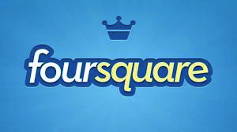



who uses data science?
Notes:
Lots of names you’d expect (also obama, nyt → politics = growth area)
Q: can you think of any others? → show some example in the browser
Soon the question will be: who doesn’t use data science?

Slide 16
who uses data science?
Recommending products on amazon.com
Identifying fraudulent credit card transactions
Recommending new musical artists
Prioritize emergency calls in Seattle
Many more!
Collaboration in the open-source arena: The WebKit case
Notes:
Lots of names you’d expect (also obama, nyt → politics = growth area)
Q: can you think of any others? → show some example in the browser
Soon the question will be: who doesn’t use data science?

Slide 17
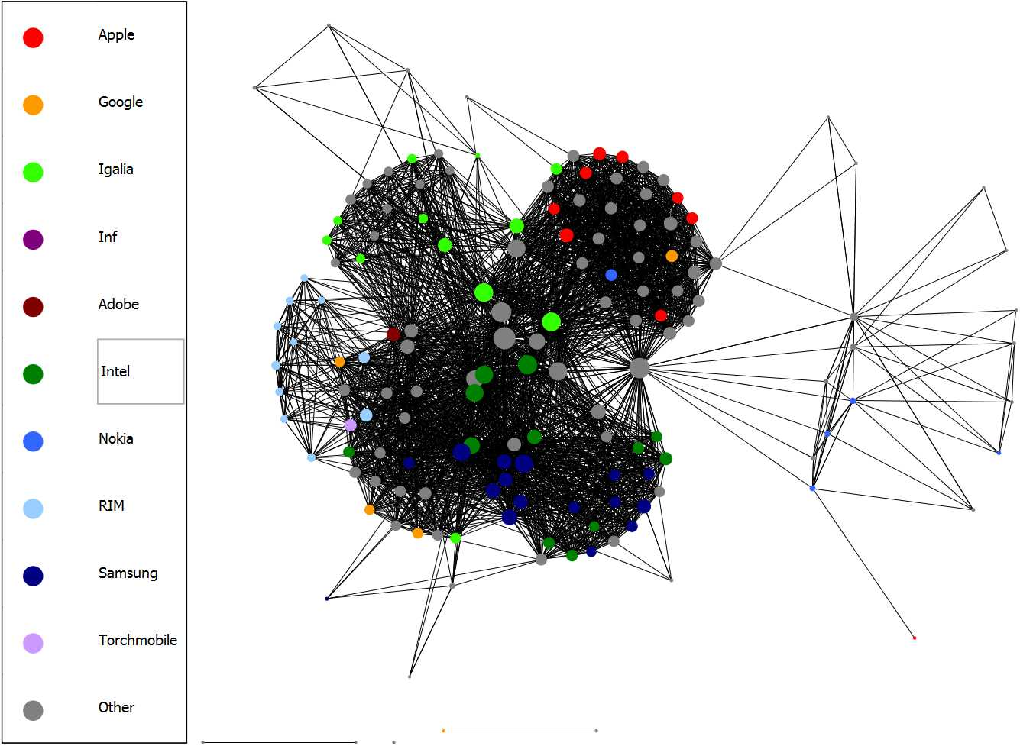
who uses data science?
Notes:
Lots of names you’d expect (also obama, nyt → politics = growth area)
Q: can you think of any others? → show some example in the browser
Soon the question will be: who doesn’t use data science?

Slide 18
who uses data science?
Application Presentations!
https://gadsdc2.hackpad.com/

Slide 19
What makes a good data scientist?
Statistical and machine learning knowledge
Engineering experience
Academic curiosity
Product sense
Storytelling
Cleverness
Notes:
Lots of names you’d expect (also obama, nyt → politics = growth area)
Q: can you think of any others? → show some example in the browser
Soon the question will be: who doesn’t use data science?

Slide 20
What makes a good data scientist?
Notes:
Lots of names you’d expect (also obama, nyt → politics = growth area)
Q: can you think of any others? → show some example in the browser
Soon the question will be: who doesn’t use data science?

Slide 21
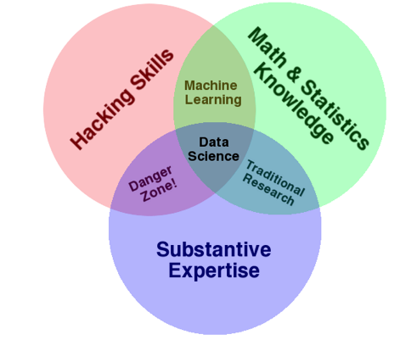
The qualities of a data scientist
source: http://www.dataists.com/2010/09/the-data-science-venn-diagram/
Notes:
Q: what could go wrong in the danger zone?

Slide 22

The qualities of a data scientist
ONE MORE THING!
Communication skills
source: http://www.dataists.com/2010/09/the-data-science-venn-diagram/
Notes:
without good communication skills, none of these will be much good to anyone
A data scientist’s most important responsibility (arguably) is explaining things clearly, often to non-technical people

Slide 23
The qualities of a data scientist
ONE MORE THING!
Communication skills
ANOTHER THING!
Answer a question!
source: http://www.dataists.com/2010/09/the-data-science-venn-diagram/
Notes:
without good communication skills, none of these will be much good to anyone
A data scientist’s most important responsibility (arguably) is explaining things clearly, often to non-technical people

Slide 24
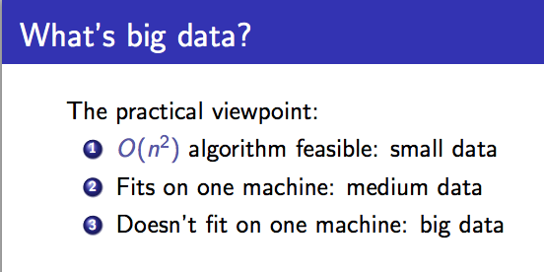
Buzzword break
source: http://people.cs.umass.edu/~mcgregor/stocworkshop/langford.pdf

Slide 25
Ii. The data science workflow
INTRO TO DATA SCIENCE
Notes:
~15-20 min for this section?
So what does data science look like?

Slide 26
the data science workflow
from Jeff Hammerbacher:
1. Identify problem
2. Instrument data sources
3. Collect data
4. Prepare data (integrate, transform, clean, impute, filter, aggregate)
5. Build model
6. Evaluate model
7. Communicate results
source: http://berkeleydatascience.files.wordpress.com/2012/01/20120117berkeley1.pdf
Notes:
Fits into our earlier characterization pretty well (problem solving skills necessary throughout!)
New headers connected to visualization (part of communication)
Q: are these in order? (A: there really is no order)

Slide 27
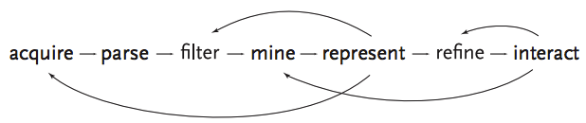
the data science workflow
ALSO:
scale
source: http://benfry.com/phd/dissertation-110323c.pdf
Notes:
Solving problems iteratively: not a straight line (eg, there’s really no correct order)
Start small & work your way out…Don’t try to do everything in a single step!
Q: why not?

Slide 28
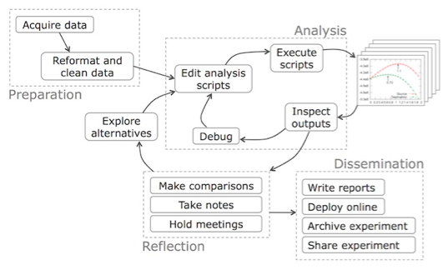
the data science workflow
source: Phillip Guo - BLOG@CACM Data Science Workflow: Overview and Challenge
Notes:
Solving problems iteratively: not a straight line (eg, there’s really no correct order)
Start small & work your way out…Don’t try to do everything in a single step!
Q: why not?

Slide 29
IiI. working at the unix command line
INTRO TO DATA SCIENCE
Notes:
~45 min?
Let’s do some warmups before we start hacking at our first dataset

Slide 30
Exercise – working at the unix command line
Key objectives
tools
- Navigate the filesystem
- Create, move, copy, and delete files & directories
- View & search files
- Edit & interact with files
- Combine steps
- Learn more
- ls, cd
- cat, touch, mv, cp, mkdir, rm, rmdir
- head, tail, less, cat, grep
- vim, tr, sort, uniq, wc
- pipe (|)
- man, apropos
NOTE
Being comfortable at the command line makes your life much easier!
Notes:
These are some initial very *practical* command line tools…we will be using these regularly & seeing many more as the course progresses (discuss why to do this before loading into R/Python)
Q: are any of these unfamiliar? Can you think of any other important basic tools?
Q: who has heard of/used vim, emacs, gnuplot, numpy/scipy/pandas, homebrew, tmux, julia? Just (to get an idea of the pace of the class)

Slide 31
git
working at the unix command line
Notes:
~15-20 min for this section?

Slide 32
Line-oriented pipelines
working at the unix command line
Notes:
~15-20 min for this section?

Slide 33
INTRO TO DATA SCIENCE

